Slide 1
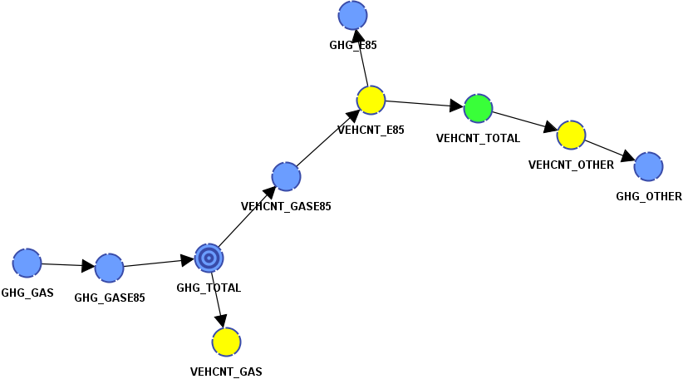
GSA Hackathon – Oct 16, 2015 (follow-up work) Green House Gas (GHG) Reduction Visualization Challenge– Bayesian Network Modeling
Pragyansmita Nayak (CGI)
Abdy Amin, Andrew Weiss (Microsoft)
October 16, 2015

Slide 2
Bayesian Network (BN) Models
Bayes Belief Network (BBN) are graphical models used to represent and approximate joint distributions over sets of variables.
The inter-connections structure of the graphical model represents the dependencies among the set of variables.
The goal of learning a graphical model is to learn both:
the graphical structure (qualitative knowledge) and
the parameters of the approximate joint distribution (quantitative knowledge) from data.
Discretization methods required for Bayesian Network modeling are used to convert the numeric data to categorical data based on the provided data breaks.
Method applied can have impact on the predictive accuracy and fit of the model. Available methods include: equal frequency, k-means among others.
Number of data breaks important for the right-fit of the model, without overfitting.
Notes:
Include graph here as example

Slide 3
BN Modeling Tool applied
BayesiaLab 5.4 (http://www.bayesia.us) is a powerful Artificial Intelligence software (Win/Mac/Unix), which provides scientists a comprehensive “lab” environment for machine learning, knowledge modeling, analytics, simulation, and optimization.
Since the trial version of BayesiaLab only allows 10 nodes (in other words, 10 variables of the dataset), the GHG and vehicle count attributes were only included in the analysis.
Using different levels of discretization, different networks were formulated.

Slide 4
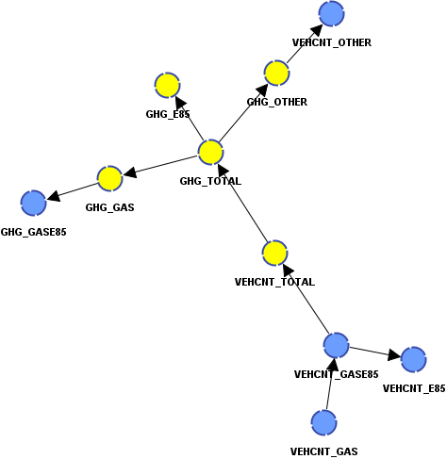
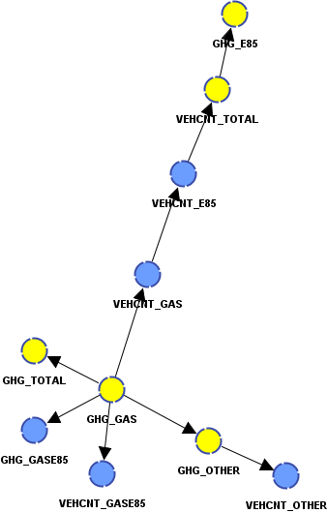
Networks Generated for k-means discretization
Number of data points = 47
Number of discretization levels attempted for each variable = 3, 5, 10
3-level
5-level
10-level

Slide 5
The 10-level BN Model

Slide 6
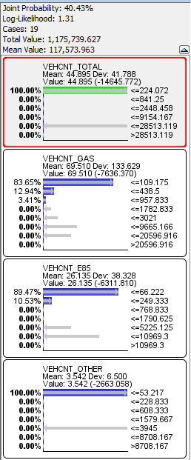
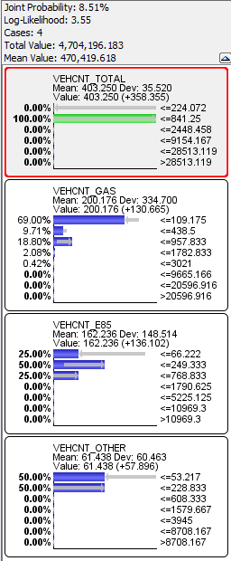
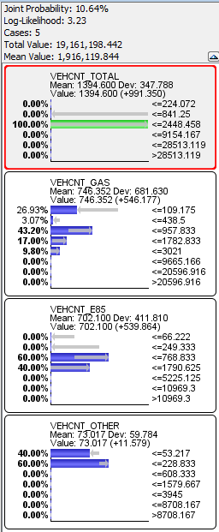
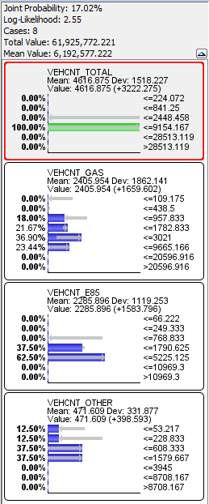
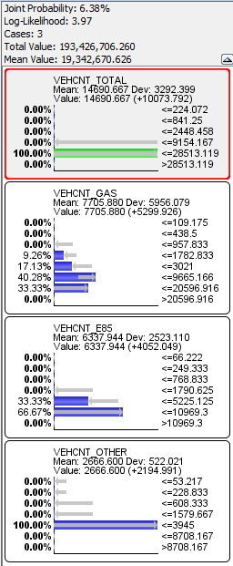
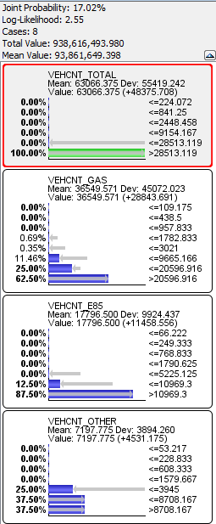
Policy Analysis Case 1: Vehicle Distribution
Better understanding of “types of vehicle” ownership.
If policies need to be formulated based on agencies with large-scale, medium-scale and low-scale of vehicle ownership, the above represents the distribution of different vehicle types.

Slide 7
Policy Analysis Case 1: Vehicle Distribution (zoom view – repeat of previous slide)

Slide 8
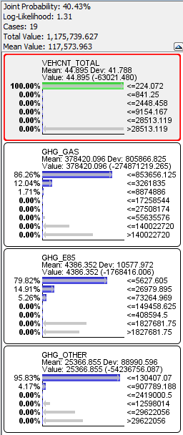
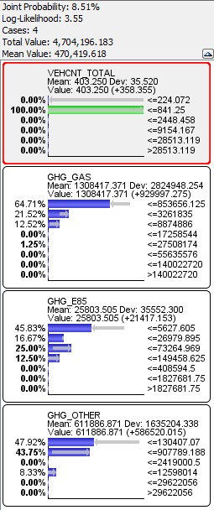
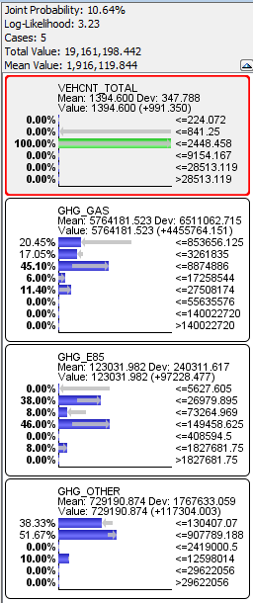
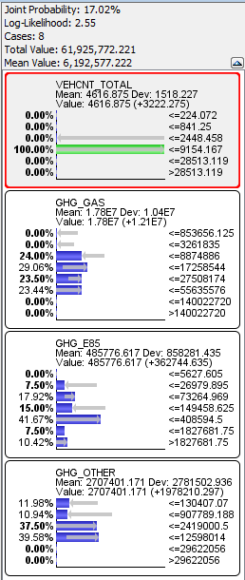
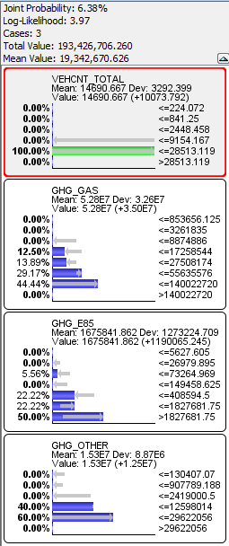
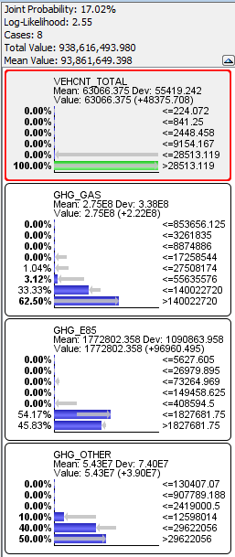
Policy Analysis Case 2: GHG Distribution
Better understanding of vehicle count distribution.
Displays a better understanding of the Vehicle count and it’s associated likelihood of the different GHG types (Gas, E85, Other such as biodiesel) – useful for policy formulation such as which agencies to target based on vehicle count and which type of GHG will reduce with maximum likelihood.
Useful view for policy formulation

Slide 9
Policy Analysis Case 1: GHG Distribution (zoom view – repeat of previous slide)

Slide 10
Future Work
Include all the attributes in the BN analysis.
Expand the dataset, if required.
Explore more what-if analysis scenarios to take the maximum advantage of the Bayesian Network models.
Explore other machine learning and visualization based approaches.

